Slide 1
Getting Kubernetes

Slide 2

Overview
Getting kubectl
Getting K8s on Your Laptop Getting K8s in the Cloud Recap

Slide 3
Getting kubectl

Slide 4

K8s cluster
$ kubectl
Manage
{}
api srv

Slide 5
Powershell
Install-Script -Name 'install-kubectl' -Scope CurrentUser -Force
install-kubectl.ps1 c:\kubectl
Choco
choco install Kubernetes-cli
Scoop
scoop install kubectl

Slide 7
Up Next:
Getting K8s on Your Laptop

Slide 8
Getting K8s on Your Laptop

Slide 9
Kubernetes on Your Laptop
Not for production!
Requires virtualization in BIOS and OS
The way to install stuff changes over time

Slide 10
Up Next:
Getting K8s in the Cloud

Slide 11
Getting K8s in the Cloud

Slide 12

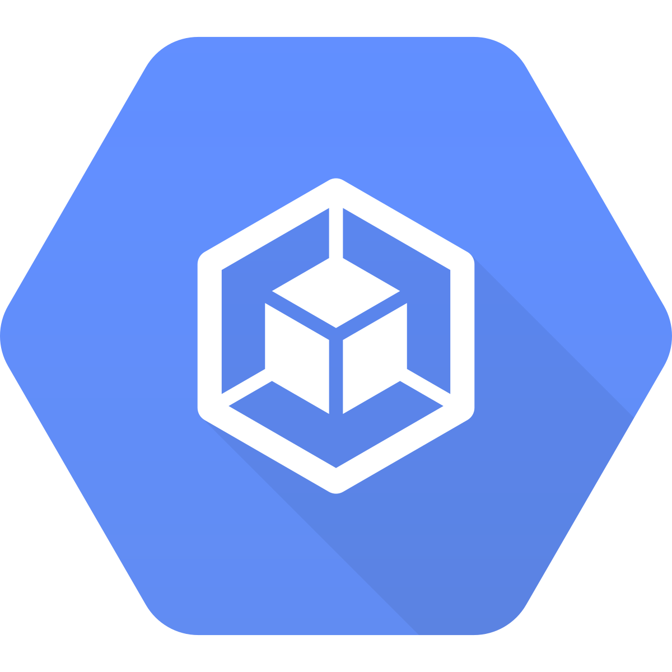
K8s in the Cloud
Linode Kubernetes Engine (LKE)
Google Kubernetes Engine (GKE)
*Lots of other great options exist!

Slide 13
Beware of cloud costs!
I’ve got the scars…

Slide 14
Recap

Slide 15
Up Next:
Kubernetes Pods

